Slide 1
Digital Design &
Computer Architecture
Sarah Harris & David Harris
Chapter 8:
Memory Systems

Slide 2
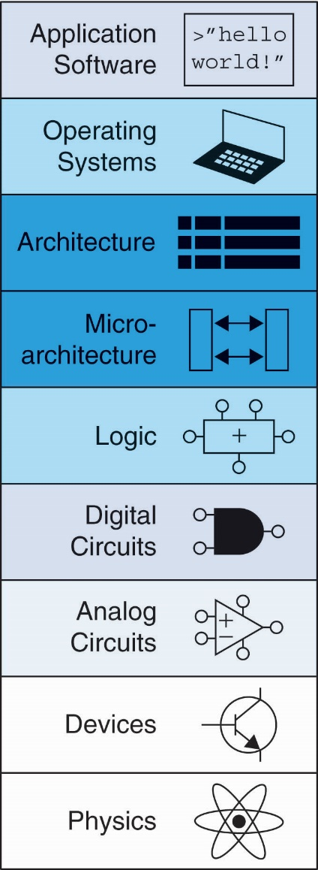
Chapter 8 :: Topics
Introduction
Memory System Performance Analysis
Caches
Virtual Memory

Slide 3
Introduction
Computer performance depends on:
Processor performance
Memory system performance
Processor / Memory Interface:

Slide 4
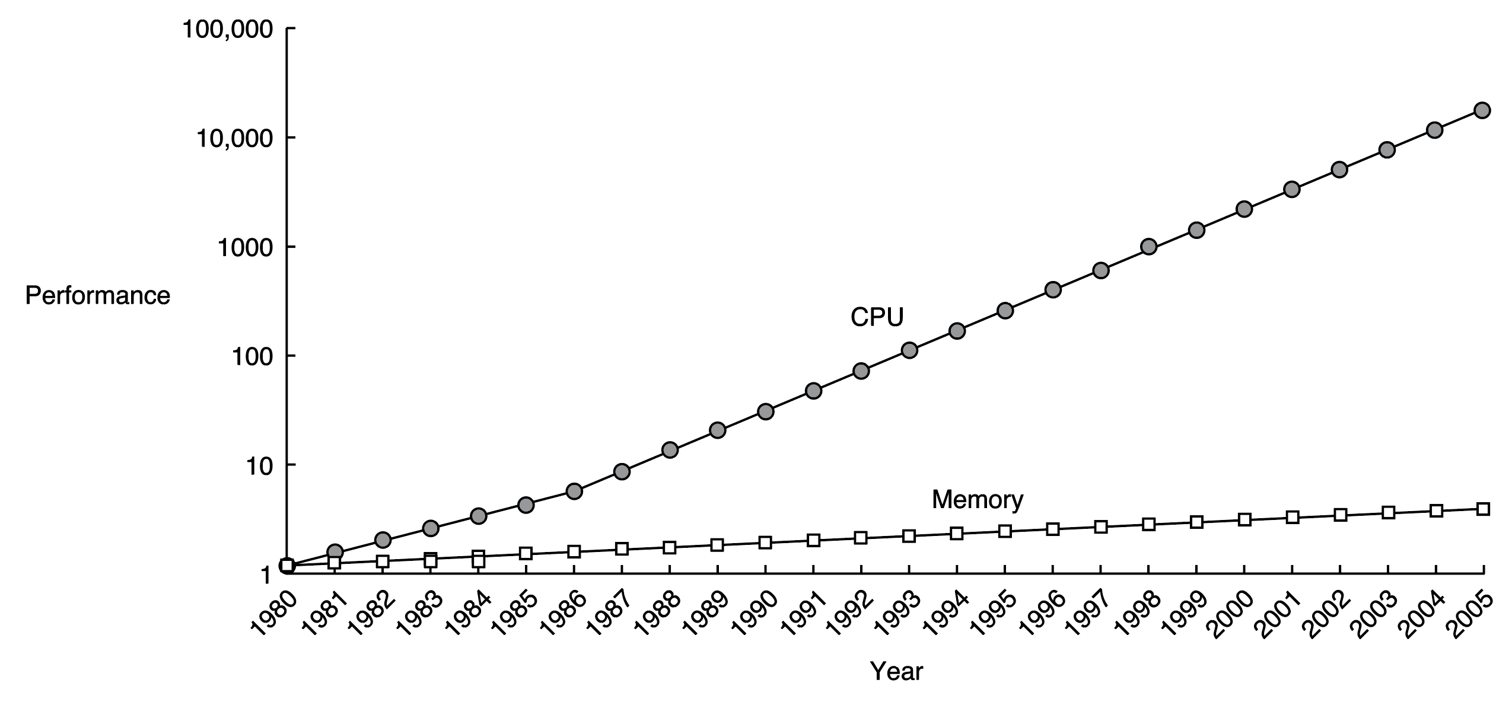
Processor-Memory Gap
In prior chapters, assumed access memory in 1 clock cycle – but hasn’t been true since the 1980’s.

Slide 5
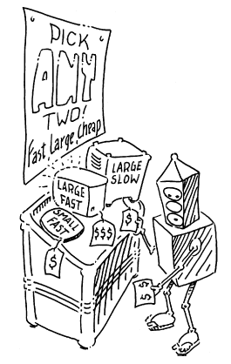
Memory System Challenge
Make memory system appear as fast as processor
Use hierarchy of memories
Ideal memory:
Fast
Cheap (inexpensive)
Large (capacity)
But can only choose two!

Slide 6
Memory Hierarchy

Slide 7
Locality
Exploit locality to make memory accesses fast:
Temporal Locality:
Locality in time
If data used recently, likely to use it again soon
How to exploit: keep recently accessed data in higher levels of memory hierarchy
Spatial Locality:
Locality in space
If data used recently, likely to use nearby data soon
How to exploit: when access data, bring nearby data into higher levels of memory hierarchy too

Slide 8
Chapter 8: Memory Systems
Memory Performance

Slide 9
Memory Performance
Hit: data found in that level of memory hierarchy
Miss: data not found (must go to next level)
Hit Rate = # hits / # memory accesses
= 1 – Miss Rate
Miss Rate = # misses / # memory accesses
= 1 – Hit Rate
Average memory access time (AMAT): average time for processor to access data
AMAT = t_{cache} + MR_{cache}[t_{MM} + MR_{MM}(t_{VM})]

Slide 10
Memory Performance Example 1
A program has 2,000 loads and stores
1,250 of these data values in cache
Rest supplied by other levels of memory hierarchy
What are the cache hit and miss rates?
Hit Rate = 1250/2000 = 0.625
Miss Rate = 750/2000 = 0.375 = 1 – Hit Rate

Slide 11
Memory Performance Example 2
Suppose processor has 2 levels of hierarchy: cache and main memory
t_{cache} = 1 cycle, t_{MM} = 100 cycles
What is the AMAT (average memory access time) of the program from Example 1?
AMAT = t_{cache} + MR_{cache}(t_{MM})
= [1 + 0.375(100)] cycles
= 38.5 cycles

Slide 12
Gene Amdahl, 1922 -
Amdahl’s Law: the effort spent increasing the performance of a subsystem is wasted unless the subsystem affects a large percentage of overall performance
Co-founded 3 companies, including one called Amdahl Corporation in 1970

Slide 13
Chapter 8: Memory Systems
Caches

Slide 14
Cache
Highest level in memory hierarchy
Fast (typically ~ 1 cycle access time)
Ideally supplies most data to processor
Usually holds most recently accessed data

Slide 15
Cache Design Questions
What data is held in the cache?
How is data found?
What data is replaced?
We focus on data loads, but stores follow the same principles.

Slide 16
What data is held in the cache?
Ideally, cache anticipates needed data and puts it in cache
But impossible to predict future
Use past to predict future – temporal and spatial locality:
Temporal locality: copy newly accessed data into cache
Spatial locality: copy neighboring data into cache too

Slide 17
Cache Terminology
Capacity (C):
number of data bytes in cache
Block size (b):
bytes of data brought into cache at once
Number of blocks (B = C/b):
number of blocks in cache: B = C/b
Degree of associativity (N):
number of blocks in a set
Number of sets (S = B/N):
each memory address maps to exactly one cache set

Slide 18
How is data found?
Cache organized into S sets
Each memory address maps to exactly one set
Caches categorized by # of blocks in a set:
Direct mapped: 1 block per set
N-way set associative: N blocks per set
Fully associative: all cache blocks in 1 set
Examine each organization for a cache with:
Capacity (C = 8 words)
Block size (b = 1 word)
So, number of blocks (B = 8)

Slide 19
Example Cache Parameters
C = 8 words (capacity)
b = 1 word (block size)
So, B = 8 (# of blocks)
Ridiculously small, but will illustrate organizations

Slide 20
Chapter 8: Memory Systems
Direct-Mapped Caches

Slide 21
Direct Mapped Cache

Slide 22
Direct Mapped Cache Hardware

Slide 23
Direct Mapped Cache Performance
# RISC-V assembly code
addi s0, zero, 5
addi s1, zero, 0
LOOP: beq s0, zero, DONE
lw s2, 4(s1)
lw s3, 12(s1)
lw s4, 8(s1)
addi s0, s0, -1
j LOOP
DONE:
Miss Rate = 3/15
= 20%
Temporal Locality
Compulsory Misses

Slide 24
Direct Mapped Cache: Conflict Miss
# RISC-V assembly code
addi s0, zero, 5
addi s1, zero, 0
LOOP: beq s0, zero, DONE
lw s2, 0x4(s1)
lw s4, 0x24(s1)
addi s0, s0, -1
j LOOP
DONE:
Miss Rate = 10/10
= 100%
Conflict Misses

Slide 25
Chapter 8: Memory Systems
Associative Caches

Slide 26
N-Way Set Associative Cache
Conflict Misses

Slide 27
# RISC-V assembly code
addi s0, zero, 5
addi s1, zero, 0
LOOP: beq s0, zero, DONE
lw s2, 0x4(s1)
lw s4, 0x24(s1)
addi s0, s0, -1
j LOOP
DONE:
N-Way Set Assoc. Cache Performance
Miss Rate = 2/10
= 20%
Associativity reduces
conflict misses
Conflict Misses

Slide 28
Fully Associative Cache
Reduces conflict misses
Expensive to build
Conflict Misses

Slide 29
Chapter 8: Memory Systems
Spatial Locality

Slide 30
Spatial Locality
Increase block size:
Block size, b = 4 words
C = 8 words
Direct mapped (1 block per set)
Number of blocks, B = 2 (C/b = 8/4 = 2)

Slide 31
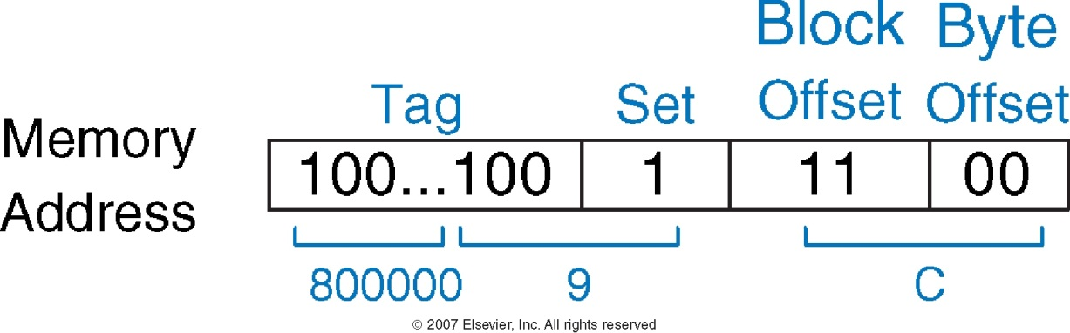
Cache with Larger Block Size

Slide 32
addi s0, zero, 5
addi s1, zero, 0
LOOP: beq s0, zero, DONE
lw s2, 4(s1)
lw s3, 12(s1)
lw s4, 8(s1)
addi s0, s0, -1
j LOOP
DONE:
Cache Perf. with Spatial Locality
Miss Rate = 1/15
= 6.67%
Larger blocks reduce
compulsory misses
through spatial locality

Slide 33
Types of Misses
Compulsory: first time data accessed
Capacity: cache too small to hold all data of interest
Conflict: data of interest maps to same location in cache
Miss penalty: time it takes to retrieve a block from lower level of hierarchy

Slide 34
Cache Organization Recap
Capacity: C
Block size: b
Number of blocks in cache: B = C/b
Number of blocks in a set: N
Number of sets: S = B/N
Organization | Number of Ways (N) | Number of Sets (S = B/N)
Direct Mapped | 1 | B
N-Way Set Associative | 1 < N < B | B / N
Fully Associative | B | 1

Slide 35
Chapter 8: Memory Systems
Cache Replacement Policy

Slide 36
Replacement Policy
Cache is too small to hold all data of interest at once
If cache full: program accesses data X and evicts data Y
Capacity miss when access Y again
How to choose Y to minimize chance of needing it again?
Least recently used (LRU) replacement: the least recently used block in a set evicted

Slide 37
LRU Replacement
# RISC-V assembly
lw s1, 0x04(zero)
lw s2, 0x24(zero)
lw s3, 0x54(zero)

Slide 38
Chapter 8: Memory Systems
Cache Summary

Slide 39
Cache Summary
What data is held in the cache?
Recently used data (temporal locality)
Nearby data (spatial locality)
How is data found?
Set is determined by address of data
Word within block also determined by address
In associative caches, data could be in one of several ways
What data is replaced?
Least-recently used way in the set

Slide 40
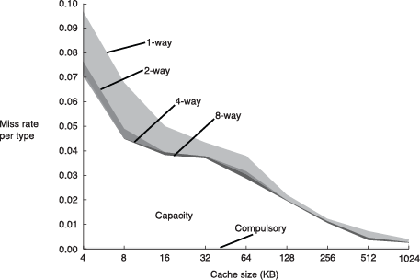
Miss Rate Trends
Bigger caches reduce capacity misses
Greater associativity reduces conflict misses
Adapted from Patterson & Hennessy, Computer Architecture: A Quantitative Approach, 2011

Slide 41
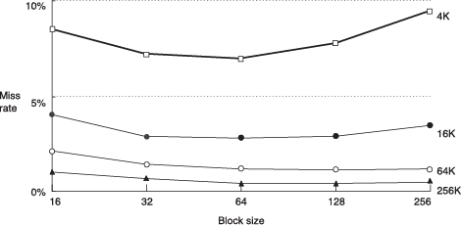
Miss Rate Trends
Bigger blocks reduce compulsory misses
Bigger blocks increase conflict misses

Slide 42
Multilevel Caches
Larger caches have lower miss rates, longer access times
Expand memory hierarchy to multiple levels of caches
Level 1: small and fast (e.g. 16 KB, 1 cycle)
Level 2: larger and slower (e.g. 256 KB, 2-6 cycles)
Most modern PCs have L1, L2, and L3 cache

Slide 43
Intel Pentium III Die
© Intel Corp.

Slide 44
Chapter 8: Memory Systems
Virtual Memory

Slide 45
Virtual Memory
Gives the illusion of bigger memory
Main memory (DRAM) acts as cache for hard disk

Slide 46
Memory Hierarchy
Physical Memory: DRAM (Main Memory)
Virtual Memory: Hard drive
Slow, Large, Cheap

Slide 47
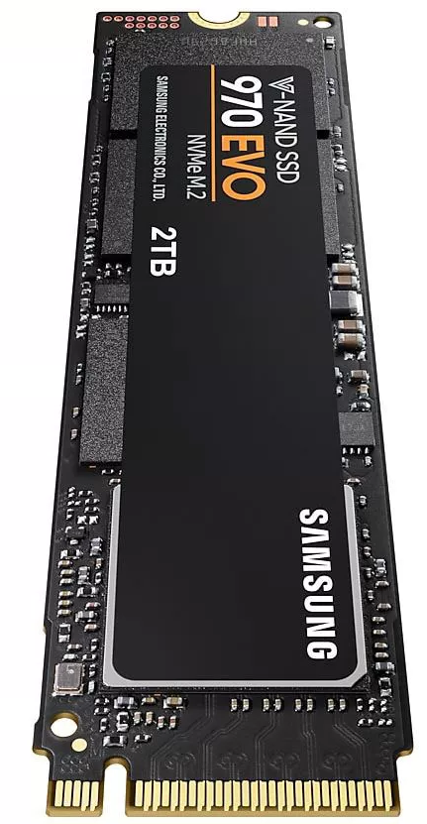
Memory Hierarchy
Hard Disk Drive
Solid State Drive
Takes milliseconds to seek correct location on disk
Arshane88 / CC BY-SA 4.0 / Wikimedia Commons

Slide 48
Virtual Memory
Virtual addresses
Programs use virtual addresses
Entire virtual address space stored on a hard drive
Subset of virtual address data in DRAM
CPU translates virtual addresses into physical addresses (DRAM addresses)
Data not in DRAM fetched from hard drive
Memory Protection
Each program has own virtual to physical mapping
Two programs can use same virtual address for different data
Programs don’t need to be aware others are running
One program (or virus) can’t corrupt memory used by another

Slide 49
Virtual Memory
Cache | Virtual Memory
Block | Page
Block Size | Page Size
Block Offset | Page Offset
Miss | Page Fault
Tag | Virtual Page Number
Physical memory acts as cache for virtual memory

Slide 50
Virtual Memory Definitions
Page size: amount of memory transferred from hard disk to DRAM at once
Address translation: determining physical address from virtual address
Page table: lookup table used to translate virtual addresses to physical addresses

Slide 51
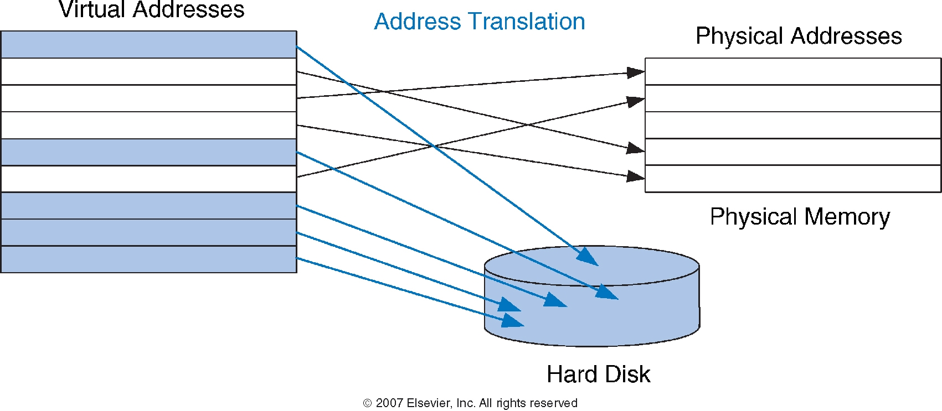
Virtual Memory Definitions
Most accesses hit in physical memory
But programs have the large capacity of virtual memory

Slide 52
Chapter 8: Memory Systems
Address Translation

Slide 53
Address Translation

Slide 54
Virtual Memory Example
System:
Virtual memory size: 2 GB = 2³¹ bytes
Physical memory size: 128 MB = 2²⁷ bytes
Page size: 4 KB = 2¹² bytes
Organization:
Virtual address: 31 bits
Physical address: 27 bits
Page offset: 12 bits
# Virtual pages = 2³¹/2¹² = 2¹⁹ (VPN = 19 bits)
# Physical pages = 2²⁷/2¹² = 2¹⁵ (PPN = 15 bits)

Slide 55
Virtual Memory Example
19-bit virtual page numbers (VPN)
15-bit physical page numbers (PPN)

Slide 56
Virtual Memory Example
What is the physical address of virtual address 0x247C?
VPN = 0x2
VPN 0x2 maps to PPN 0x7FFF
12-bit page offset: 0x47C
Physical address = 0x7FFF47C

Slide 57
Chapter 8: Memory Systems
Page Table

Slide 58
How to Perform Translation
Page table
Entry for each virtual page
Entry fields:
Valid bit: 1 if page in physical memory
Physical page number: where the page is located

Slide 59
Page Table Example
VPN is index into page table

Slide 60
Page Table Example 1
What is the physical address of virtual address 0x5F20?
VPN = 5
Entry 5 in page table VPN 5 => physical page 1
Physical address: 0x1F20

Slide 61
Page Table Example 2
What is the physical address of virtual address 0x73E4?
VPN = 7
Entry 7 is invalid
Virtual page must be paged into physical memory from disk

Slide 62
Page Table Challenges
Page table is large
usually located in physical memory
Load/store requires 2 main memory accesses:
one for translation (page table read)
one to access data (after translation)
Cuts memory performance in half
Unless we get clever…

Slide 63
Chapter 8: Memory Systems
Translation Lookaside Buffer (TLB)

Slide 64
Translation Lookaside Buffer (TLB)
Small cache of most recent translations
Reduces number of memory accesses for most loads/stores from 2 to 1

Slide 65
TLB
Page table accesses: high temporal locality
Large page size, so consecutive loads/stores likely to access same page
TLB
Small: accessed in < 1 cycle
Typically 16 - 512 entries
Fully associative
> 99% hit rates typical
Reduces number of memory accesses for most loads/stores from 2 to 1

Slide 66
Example: 2-entry TLB

Slide 67
Chapter 8: Memory Systems
Virtual Memory Summary

Slide 68
Memory Protection
Multiple processes (programs) run at once
Each process has its own page table
Each process can use entire virtual address space
A process can only access a subset of physical pages: those mapped in its own page table

Slide 69
Virtual Memory Summary
Virtual memory increases capacity
A subset of virtual pages in physical memory
Page table maps virtual pages to physical pages – address translation
A TLB speeds up address translation
Different page tables for different programs provides memory protection

Slide 70
About these Notes
Digital Design and Computer Architecture Lecture Notes
© 2021 Sarah Harris and David Harris
These notes may be used and modified for educational and/or non-commercial purposes so long as the source is attributed.

